Slide 1
MATHEMATICAL FOUNDATION FOR COMPUTER SCIENCE
Prepared by: Er. Ankit Kharel
Nepal college of information technology

Slide 2
Rules of inference

Slide 3
ARGUMENT:
An argument is a sequence of proposition written as:
P₁, P₂ …..are called the Hypothesis or premises and the proposition Q is called Conclusion.
The argument is valid provided that P₁, P₂ ……and P_{n} all are TRUE ,then Q also must be TRUE.
This process of Drawing a conclusion from a sequence of proposition is called Deductive Reasoning.
P₁
P₂
.
.
. (P₁^P₂……..P_{n})→Q is TAUTOLOGY
.
.
.
P_{n}
∴ q_{n}

Slide 4
RULES OF INFERENCE:
If an argument consists of 10 different proposition variable then 2¹⁰=1024 combination are needed for Truth Table which is a tedious approach.
Instead we can first establish the validity of some relatively simple arguments forms, called Rules of Inference.
These rules then can be used to construct more complicated valid arguments.

Slide 5
1. MODUS PONENS:
It states that if P and P→Q is TRUE then, we can infer Q is true.
That is, (P^(P→Q))→Q is TAUTOLOGY
p → q
p
∴ q
Proof By Truth Table:
p | q | p→q | (p→q) ^p | ((p→q) ^p)→q
T | T | T | T | T
T | F | F | F | T
F | T | T | F | T
F | F | T | F | T

Slide 6
2. MODUS TOLLENS:
It states that if P→Q and ¬Q is TRUE then, we can infer ¬P is true.
That is, (¬q^(P→Q))→¬P is TAUTOLOGY
p → q
¬q
∴ ¬p
Proof By Truth Table:
p | q | p→q | ¬p | ¬q | (p→q) ^¬q | (p→q) ^¬q)→¬p
T | T | T | F | F | F | T
T | F | F | F | T | F | T
F | T | T | T | F | F | T
F | F | T | T | T | T | T

Slide 7
3. HYPOTHETICAL SYLLOGISM:
It states that if P→Q and Q→R is TRUE then, we can infer P→R is true.
That is, ((P→Q)^(Q→R))→(P→R) is TAUTOLOGY
p→q
q→r
∴ p→r
P | q | r | p→q | q→r | p→r | (p→q)^(q→r) | ((p→q)^(q→r))→(p→r)
T | T | T | T | T | T | T | T
T | T | F | T | F | F | F | T
T | F | T | F | T | T | F | T
T | F | F | F | T | F | F | T
F | T | T | T | T | T | T | T
F | T | F | T | F | T | F | T
F | F | T | T | T | T | T | T
F | F | F | T | T | T | T | T

Slide 8
4. DISJUNCTIVE SYLLOGISM:
It states that if PvQ and ¬P is TRUE then, we can infer Q is true.
That is, (¬P^(PvQ))→Q is TAUTOLOGY
pVq
¬p
∴ q
Proof By Truth Table:
p | q | pVq | ¬p | (pVq)^¬p | ((pVq)^¬p)→q
T | T | T | F | F | T
T | F | T | F | F | T
F | T | T | T | T | T
F | F | F | T | F | T

Slide 9
5. ADDITION:
It states that if P is TRUE then, PvQ will be TRUE.
That is, P→(PvQ) is TAUTOLOGY
p
∴ pVq
Proof By Truth Table:
p | q | pVq | P→(pVq)
T | T | T | T
T | F | T | T
F | T | T | T
F | F | F | T

Slide 10
6. SIMPLIFICATION:
It states that if P^Q is TRUE then, P will be TRUE.
That is, (P^Q)→P is TAUTOLOGY
p^q
∴ p
Proof By Truth Table:
p | q | p^q | (p^q)→p
T | T | T | T
T | F | F | T
F | T | F | T
F | F | F | T

Slide 11
7. CONJUNCTION:
It states that if P is TRUE and Q is TRUE then, P^Q will be TRUE.
That is, (P)^(Q)→(P^Q) is TAUTOLOGY
p
q
∴ p^q
Proof By Truth Table:
p | q | p^q | (p^q)→(p^q)
T | T | T | T
T | F | F | T
F | T | F | T
F | F | F | T

Slide 12
8. RESOLUTION:
It states that if (PvQ) and (¬PvR) is TRUE then, we can infer (QvR) is true.
That is,((PvQ)^(¬PvR))→(QvR) is TAUTOLOGY
pVq
¬pVr
∴ qVr
p | q | r | ¬p | pVq | ¬pVr | qVr | ((pVq)^(¬pVr))→(qVr)
T | T | T | F | T | T | T | T
T | T | F | F | T | F | F | T
T | F | T | F | T | T | T | T
T | F | F | F | T | F | F | T
F | T | T | T | T | T | T | T
F | T | F | T | T | T | T | T
F | F | T | T | F | T | T | T
F | F | F | T | F | T | T | T

Slide 13
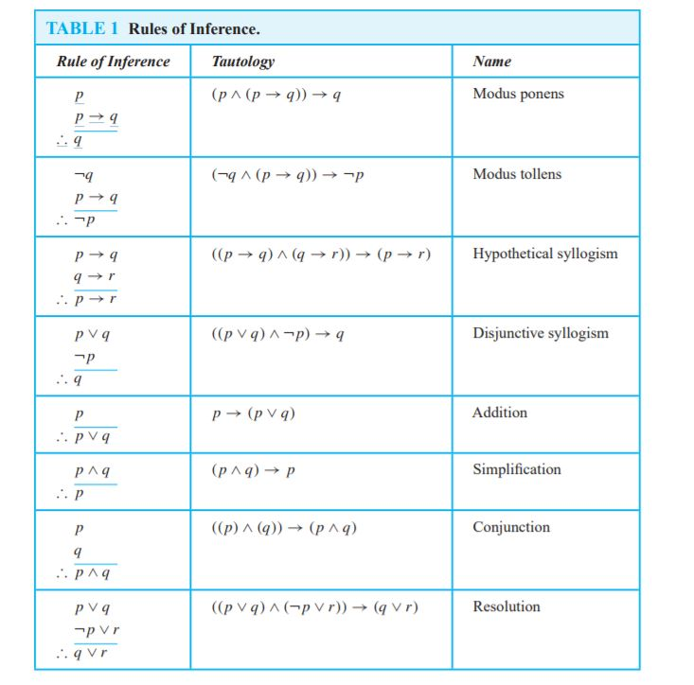
RULES OF INFERENCE:

Slide 14
Q.1)State which rule of inference is the basis of the following argument:
“It is below freezing now. Therefore, it is either below freezing or raining now.”
Solution:
Let, p : “It is below freezing now”
q : “It is raining now.”
Then this argument is of the form:
p
∴ p ∨ q
This is an argument that uses the addition rule.
Q.2)State which rule of inference is the basis of the following argument:
“It is below freezing and raining now. Therefore, it is below freezing now.”
Solution:
let, p: “It is below freezing now”
q : “It is raining now”
This argument is of the form:
p ∧ q
∴ p
This argument uses the simplification rule.

Slide 15
Q.3)State which rule of inference is the basis of the following argument:
“If you have a current password, then you can log onto the network. You have a current password. Therefore, You can log onto the network.”
Solution:
Let, p : “you have a current password”
q : “you can log onto the network”
Then this argument is of the form:
p → q
p
∴ q
This is an argument that uses the Modus Ponens rule.
Q.4)State which rule of inference is the basis of the following argument:
“If it rains today, then we will not have a barbecue today. If we do not have a barbecue today, then we will have a barbecue tomorrow. Therefore, if it rains today, then we will have a barbecue tomorrow”
Solution:
let, p: “it rains today”
q : “We will have a barbecue today”
r : “we will have a barbecue tomorrow”
This argument is of the form:
p → ¬ q
¬q → r
∴ p → r This argument uses the Hypothetical rule.

Slide 16
Q.5) Show that the premises: “If I play football then I am tired the next day”, “I will take rest if I am tired”, “I did not take rest” will lead to the conclusion “I did not play football”.
Solution:
Let, p: “If I play football”
q: “I am tired”
r: “I will take rest ”
Hypothesis: i) p→q
ii) q →r
iii) ¬r
Conclusion: ∴ ¬p
s.n. | STEPS | REASONS
1. | p→q | Given Hypothesis
2. | q→r | Given Hypothesis
3. | p→r | HYPOTHTICAL SYLLOGISM IN 1 & 2
4. | ¬r | Given Hypothesis
5. | ¬p | MODUS TOLLENSON 3 & 4

Slide 17
Q.6) Show that the premises “It is not sunny this afternoon and it is colder than yesterday”. “We will go swimming only if it is sunny.” “If we do not go swimming, then we will take a canoe trip.” and “If we take a canoe trip, then we will be home by sunset” lead to the conclusion “We will be home by sunset.”
Solution:
Let, p: “It is sunny this afternoon”
q: “It is colder than yesterday”
r: “We will go swimming”
s: “We will take canoe trip”
t: “We will be home by sunset”
Hypothesis: i) ¬p^q
ii)r →p
iii) ¬r→s
iv)s→t
Conclusion: ∴t
s.n. | STEPS | REASONS
1. | ¬p^q | Given Hypothesis
2. | ¬p | SIMPLIFICATION ON 1
3. | r → p | Given Hypothesis
4. | ¬r | MODUS TOLLENS ON 2 & 3
5. | ¬r→s | Given Hypothesis
6. | s | MODUS PONENS ON 4 & 5
7. | s→t | Given Hypothesis
8. | t | MODUS PONENS ON 6 & 7

Slide 18
Q.7) Show that the premises “If you send me an e-mail message, then I will finish writing the program”, “If you do not send me an e-mail message, then I will go to sleep early,” “If I go to sleep early, then I will wake up feeling refreshed” lead to the conclusion “If I do not finish writing the program, then I will wake up feeling refreshed.”
Solution:
Let, p: “you send me an e-mail message”
q: “I will finish writing the program”
r: “I will go to sleep early”
s: “I will wake up feeling refreshed”
Hypothesis: i) p→q
ii) ¬p→r
iii) r→s
Conclusion: ∴ ¬q→s
s.n. | STEPS | REASONS
1. | p→q | Given Hypothesis
2. | ¬q→¬p | CONTRAPOSITIVE ON 1
3. | ¬p→r | Given Hypothesis
4. | ¬q→r | Hypothetical syllogism using (2) and (3)
5. | r→s | Given Hypothesis
6. | ¬q→s | Hypothetical syllogism using (4) and (5)

Slide 19
Q.8) Show that the premises “If it does not rain or if it is not foggy, then the sailing race will be held and the lifesaving demonstration will go on,” “If the sailing race is held, then the trophy will be awarded,” and “The trophy was not awarded” imply the conclusion “It rained.”
Solution:
Let, p: “It rains”
q: “It is foggy”
r: “The sailing race is held”
s: “Life saving demonstration is done”
t: “Trophy is awarded”
Hypothesis: i) (¬p ∨ ¬q) → (r ∧ s)
ii) r→t
iii) ¬t
Conclusion: ∴ p
s.n. | STEPS | REASONS
1. | r→t | Given Hypothesis
2. | ¬t | Given Hypothesis
3. | ¬r | MODUS TOLLENS ON 1 & 2
4. | (¬p ∨ ¬q) → (r ∧ s) | Given Hypothesis
5. | ¬r V ¬s | Addition on 3
6. | ¬(r ^ s) | DE-MORGAN’S LAW on 5
7 | ¬(¬p v ¬q) | MODUS TOLLENS ON 4 and 6
8 | p ^ q | DE-MORGAN’S LAW on 7
9 | p | SIMPLIFICATION on 8

Slide 20
Q.9) Show that the premises “If the interest rate drops , the housing market will improve”, “The federal discount rate will drop or the housing market will not improve”, “Interest rate will drop” imply the conclusion “The federal discount rate will drop”
Solution:
Let, p: “the interest rate drops ”
q: “the housing market will improve”
r: “The federal discount rate will drop”
Hypothesis: i) p→q
ii) r v ¬q
iii) p
Conclusion: ∴ r
STEPS | REASONS
1. p→q | Given Hypothesis
2. ¬p v q | Implication on 1
3. r v ¬q | Given Hypothesis
4. ¬p v r | Resolution From 2 and 3
5. p | Given hypothesis
6. r | From 4 and 5

Slide 21
Q.10) Show that the premises “If my cheque book is in office, then I have paid my phone bill”, “I was looking for phone bill at breakfast or I was looking for phone bill in my office”, “If was looking for phone bill at breakfast then my cheque book is on breakfast table” , “If I was looking for phone bill in my office then my cheque book is in my office”, “I have not paid my phone bill” imply the conclusion “My cheque book is on my breakfast table”
Solution:
Let, p: “my cheque book is in office”
q: “I have paid my phone bill”
r: “I was looking for phone bill at breakfast ”
s: “I was looking for phone bill in my office”
t: “my cheque book is on breakfast table”
Hypothesis: i) p→q
ii) r v s
iii) r→t
iv) s→p
v) ¬q
Conclusion: ∴ t

Slide 22
Hypothesis: i) p→q
ii) r v s
iii) r→t
iv) s→p
v) ¬q
Conclusion: ∴ t
STEPS | REASONS
1. p→q | Given Hypothesis
2. ¬q | Given Hypothesis
3. ¬p | Modus Tollens on 1 and 2
4. r v s | Given Hypothesis
5. r→t | Given Hypothesis
6. ¬r v t | Implication on 5
7. s v t | Resolution from 4 and 6
8. s→p | Given Hypothesis
9. ¬s v p | Implication on 8
10. t v p | Resolution from 7 and 9
11. t | From 3 and 10

Slide 23
PROOF BY RESOLUTION:
Propositional Resolution works only on expressions in clausal form. Before the rule can be applied, the premises and conclusions must be converted to this form.
A literal is either an atomic sentence or a negation of an atomic sentence. For example, if p is a logical constant, the following sentences are both literals.
p ¬p
A clausal sentence is either a literal or a disjunction of literals. If p and q are logical constants, then the following are clausal sentences.
p ¬p ¬p ∨ q
A clause is the set of literals in a clausal sentence. For example, the following sets are the clauses corresponding to the clausal sentences above.
{p} {¬p} {¬p, q}

Slide 24
CONVERTING TO CAUSAL FORM:
Examples:
1. p→q = ¬p V q
2. p←→q = (¬p V q) ^ (¬q V p)-------{CNF}
3. ¬(p ^ q) = ¬p V ¬q
4. ¬(p V q) = ¬p ^ ¬q
CNF: CNF (Conjunctive normal form) if it is a ∧(Conjunction) of ∨(Disjunction s) of literals (variables or their negation.)
DNF: DNF (Disjunctive normal form) if it is a ∨(Disjunction s) of ∧(Conjunction) of literals (variables or their negation.)
Example: 1. ¬p V ¬q
2. (p^q) V (p^r)

Slide 25
Prove:
i) P→Q
ii) ¬P→R
iii) R→S
∴ ¬Q→S
Solution:
The causal form of hypothesis and Conclusion are:
¬P v Q
P v R
¬R v S
∴ Q v S
STEPS | REASONS
1. ¬P v Q | 1. Given Hypothesis
2. P v R | 2. Given Hypothesis
3. Q v R =R v Q | 3. Using Resolution
4. ¬R v S | 4. Given Hypothesis
5. Q v S | 4. Using Resolution

Slide 26
Using Graphical Method:
Prove:
i) P→Q
ii) ¬P→R
iii) R→S
∴ ¬Q→S
STEP 1. The causal form of hypothesis and Conclusion are:
¬P v Q
P v R
¬R v S
∴ Q v S
STEP 2.
¬P v Q
P v R
Q v R
¬R v S
Q v S

Slide 27
Using Graphical Method:
Prove:
i) P
ii) P→R
iii) R→S
∴ S
STEP 1. The causal form of hypothesis and Conclusion are:
P
¬P v R
¬R v S
∴ S
STEP 2.
P
¬P v R
R
¬R v S
S

Slide 28
Using resolution principle, prove that the hypotheses: "If today is Tuesday then I will have a test in Discreet Math or Microprocessor”. “If my Microprocessor teacher is sick then I will not have a test in Microprocessor." “Today is Tuesday and my Microprocessor teacher is sick." lead to the conclusion that “I will have a test in Discrete Math“
Solution:
Let, p : “Today is Tuesday”
q : “I will have test in Discrete Math”
r : “I will have test in Microprocessor”
s : “My Microprocessor teacher is sick”
Hypothesis: i) p→(q V r)
ii) s→ ¬r
iii) p ^ s
Conclusion: q
The Causal Forms are:
Hypothesis:
¬p V (q V r)
¬s V ¬r
p
s
Conclusion:
∴ q

Slide 29
The Causal Forms are:
Hypothesis:
¬p V (q V r)
¬s V ¬r
p
s
Conclusion:
∴ q
STEPS | REASONS
1. ¬p V (q V r) | Given Hypothesis
2. p | Given Hypothesis
3. q V r | From 1 and 2
4. ¬s V ¬r | Given Hypothesis
5. q V ¬s | From 3 and 4
6. s | Given Hypothesis
7. q | From 5 and 6

Slide 30
¬p V (q V r)
p
(q V r)
¬s V ¬r
The Causal Forms are:
Hypothesis:
¬p V (q V r)
¬s V ¬r
p
s
Conclusion:
∴ q
q V ¬s
s
q

Slide 31

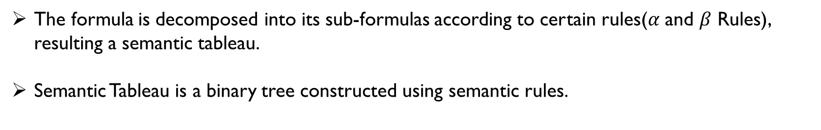
semantic tableaux:
The formula is decomposed into its sub-formulas according to certain rules($α$ and $β$ Rules), resulting a semantic tableau.
Semantic Tableau is a binary tree constructed using semantic rules.
$α Rule$
a) P v Q b)P ^ Q c)P→Q d)P←→Q
$β$ Rule
a) ¬(¬P) b) ¬(P v Q) c) ¬(P ^ Q) d) ¬(P→Q) e) ¬(P←→Q)
P
Q
P
¬ P
Q
P
Q
¬P
¬Q
Q
P
¬P
¬Q
¬ P
¬ Q
P
P
¬ Q
¬P
Q
¬Q

Slide 32

semantic tableaux:
A finite set of formulas $φ$ is satisfiable iff T($φ$) is open.
As a corollary, $φ$is contradictory (not satisfiable) iff T($φ$) is closed
$φ$=(P v Q) ^ (¬P ^ ¬Q)
When P and its negation ¬P appear on the same branch, a contradiction has been found and that branch is called closed.
A=(P v Q)
B=(¬P ^ ¬Q)
P | Q | ¬P | ¬Q | A | B | A^B
T | T | F | F | T | F | F
T | F | F | T | T | F | F
F | T | T | F | T | F | F
F | F | T | T | F | T | F
(P v Q)
(¬P ^ ¬Q)
P
Q
¬P
¬P
¬Q
¬Q

Slide 33


semantic tableaux:
$φ$=(P v ¬Q) →(P ^ Q)
SATISFIABLE
(There are open branches)
$φ$=(P →Q) ^ (Q→R)
SATISFIABLE
(There are open branches)
(P ^ Q)
P→Q
Q→R
¬(P v ¬Q)
¬P
P
Q
Q
¬Q
¬P
R
¬Q
R
¬Q

Slide 34
P | Q | R | (P→Q) | (Q→R) | (P→Q)^(Q→R)
T | T | T | T | T | T
T | T | F | T | F | F
T | F | T | F | T | F
T | F | F | F | T | F
F | T | T | T | T | T
F | T | F | T | F | F
F | F | T | T | T | T
F | F | F | T | T | T
P | Q | ¬Q | A=(PV¬Q) | B=(P^Q) | A→B
T | T | F | T | T | T
T | F | T | T | F | F
F | T | F | F | F | T
F | F | T | T | F | F

Slide 35



semantic tableaux:
$φ$={ a ∧ c, (¬a ∨ b) ∧ (¬b ∨ ¬ c) }
$φ$={ a v b, (b→c) , ¬(¬a→c) }
[Disjunction First Policy]
$φ$={ a v b, (b→c) , ¬(¬a→c) }
[Conjunction First Policy]
(a ^ c)
(a v b)
b→c
¬(¬a→c)
(a v b)
b→c
¬(¬a→c)
(¬a ∨ b) ∧ (¬b ∨ ¬ c)
a
c
a
b
¬a
¬c
(¬a ∨ b)
(¬b ∨ ¬ c)
¬b
c
¬b
c
a
b
¬a
¬c
¬a
¬c
¬a
¬c
¬a
b
¬b
c
¬b
¬c

Slide 36
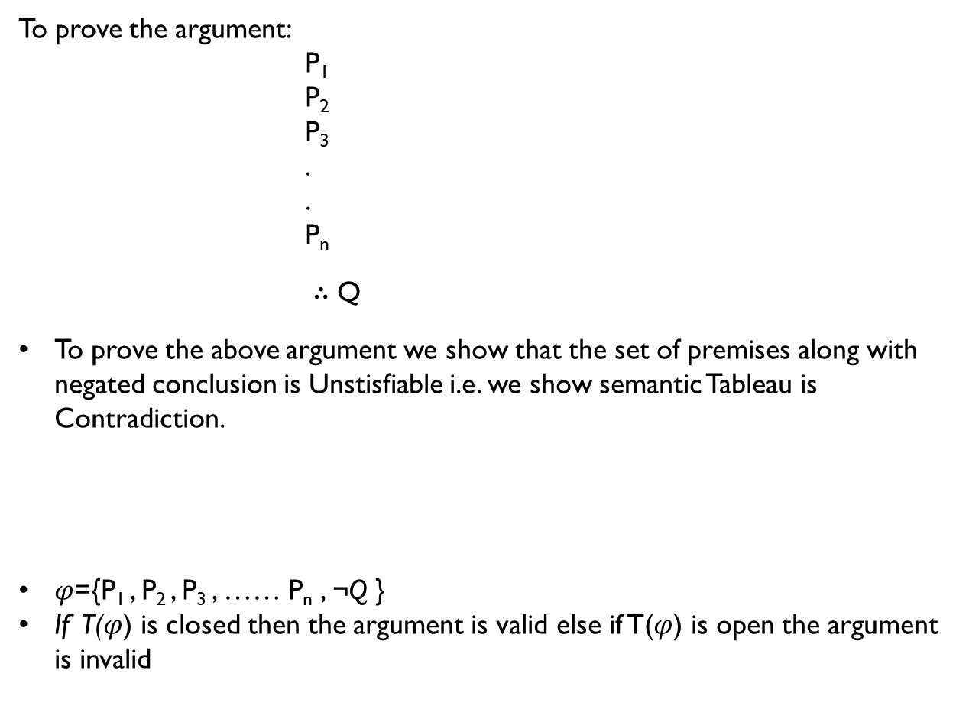
semantic tableaux:
To prove the argument:
P₁
P₂
P₃
.
.
P_{n}
∴ Q
To prove the above argument we show that the set of premises along with negated conclusion is Unstisfiable i.e. we show semantic Tableau is Contradiction.
$φ$={P₁ , P₂ , P₃ , …… P_{n} , ¬Q }
If T($φ$) is closed then the argument is valid else if T($φ$) is open the argument is invalid
[(P₁ ^ P₂ , ……. ^P_{n} )→Q] is Tautology.
= [(P₁ ^ P₂ , ……. ^ P_{n} )→Q]
= ¬[(P₁ ^ P₂ , ……. ^ P_{n} )→Q]
= [P₁ ^ P₂ , …….. ^ P_{n} ^ ¬Q]

Slide 37

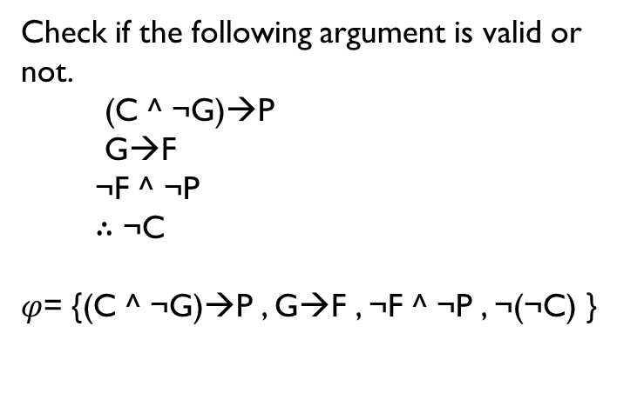
$φ$= {(C ^ ¬G)→P , G→F , ¬F ^ ¬P , ¬(¬C) }
Check if the following argument is valid or not.
(C ^ ¬G)→P
G→F
¬F ^ ¬P
∴ ¬C
$φ$= {(C ^ ¬G)→P , G→F , ¬F ^ ¬P , ¬(¬C) }
(C ^ ¬G)→P
G→F
¬F ^ ¬P
C
¬F
¬P
C
¬(C ^ ¬G)
P
¬C
G
¬G
F
The obtained Tableau is contradictory.Hence the argument is valid

Slide 38
Hypothesis: i) ¬p^q
ii)r →p
iii) ¬r→s
iv)s→t
Conclusion: ∴t
i)p→q
ii) q →r
iii) ¬r
∴ ¬p
Hypothesis: i) (¬p ∨ ¬q) → (r ∧ s)
ii) r→t
iii) ¬t
Conclusion: ∴ p
Hypothesis: i) p→q
ii) ¬p→r
iii) r→s
Conclusion: ∴ ¬q→s

